Slide 1
Chapter- 7
Network Security &
Security and protection

Slide 2
Introduction
We are living in the information age.
We need to keep information about every aspect of our lives.
In other words, information is an asset that has a value like any other asset.
Assets be hidden from unauthorized access (confidentiality),
protected from unauthorized change (integrity), and
available to an authorized entity when it is needed (availability).
Authentication computer/network system be able to verify the identity of a user(Authenticity).

Slide 3
Computer and Network Security Requirements
Confidentiality
  Message confidentiality or privacy means that the sender and the receiver expect confidentiality.
  The transmitted message must make sense to only the intended receiver.
Integrity
  Assets can be modified by authorized parties only
Availability
  Assets be available to authorized parties
Authenticity
  Requires that a computer system be able to verify the identity of a user

Slide 4
THREAT, ATTACKER AND HACKER
Threat: is also called a malicious actor , is an entity that is partially or wholly responsible for a security incident that impacts
Hacker: is any skilled computer expert that uses their technical knowledge to overcome a problem. Or it is any computer programmer
Attacker: According to Wikipedia, “In computer and computer networks an attack is any attempt to destroy, expose, alter, disable, steal or gain unauthorized access to or make unauthorized use of an asset

Slide 5
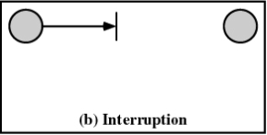
Types of Threats
Interruption:
  An asset of the system is destroyed or becomes unavailable or unusable
  Destruction of hardware
  Cutting of a communication line
  Disabling the file management system
  Generally attack on availability – denial of service attack

Slide 6
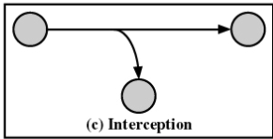
TYPES OF THREATS
Interception:
  An unauthorized party gains access to an asset
  Wiretapping to capture data in a network
  copying of files or programs
  Generally attack on confidentiality

Slide 7
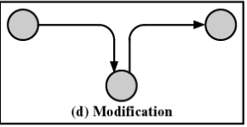
Continued..
Modification:
  An unauthorized party not only gains access but changes (tampers) an asset
  Changing values in a data file
  Altering a program so that it performs differently
  Modifying the content of messages being transmitted in a network
  Generally attack on integrity

Slide 8
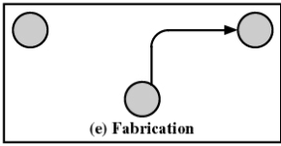
Continued…
Fabrication:
  An unauthorized party inserts counterfeit/fake objects into the system
  Insertion of spurious messages in a network
  Addition of records to a file
  Generally attack on authenticity

Slide 9
How to keep our assets from threats
By Ancient Ciphers or Modern Cryptosystems…
Cryptography:- it is Greek origins, means "secret writing.“
However, we use the term to refer to the science and art of transforming messages to make them secure and immune to attacks

Slide 10
Ancient Ciphers to Modern Cryptosystems
Some terminologies in cryptosystem
plaintext - original message
Cipher text - coded message
cipher - algorithm for transforming plaintext to cipher text
key – is set of numbers or information used in cipher
encipher (encrypt) - converting plaintext to cipher text
decipher (decrypt) - recovering cipher text from plaintext
cryptanalysis (code breaking) – is principles of deciphering cipher text without knowing key
Cryptography:- it is Greek origins, means "secret writing.“
cryptology - field of both cryptography and cryptanalysis

Slide 11



The language of cryptography
Sender encryption key
Receiver decryption key
K
K
A
B
plaintext
encryption
algorithm
ciphertext
decryption
algorithm
plaintext
m
K_{A}(m)
m = K_{B}(K_{A}(m))
hacker
m = plaintext message
K_{A}(m) = ciphertext which is encrypted with key K_{A}
m = K_{B}(K_{A}(m)) → the plain text message which decrypt with k_{B} key which encrypted with K_{A} key

Slide 12
Encryption schemes (substitution, additive and transposition)
1. substitution cipher: substituting one thing for another
  Mono alphabetic cipher: substitute one letter for another
  If key is a=m
Encryption key: mapping from set of 26 letters
to set of 26 letters
plaintext:
a | b | c | d | e | f | g | h | i | j | k | l | m | n | o | p | k | r | s | t | u | v | w | x | y | z
m | n | o | p | q | r | s | t | u | v | w | x | y | z | a | b | c | d | e | f | g | h | i | j | k | l
ciphertext:
Example:-
If Plaintext is: i love you jon What is hidden or its cipher text
Solution: ciphertext: u xahq kag vaz

Slide 13
Encryption schemes
2. Additive cipher, the plaintext, cipher text, and key are integers in modulo 26.
Encrypt the following plain text with additive cipher

Slide 14
Example encrypt the message “hello” using additive scheme
with key = 15 and a = 00 to encrypt the plain text message “hello”.
Solution: so if a=00 then b =01, c=02, d=03, e=04, … and z=25
We apply the encryption algorithm to the plaintext, character by character by adding key: 15 to character value for example 07 for character h, which becomes 07+15%26 =22 %26 = 22
Plain Text
Encryption
Cipher Text
So the result information is:
wtaad

Slide 15
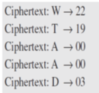
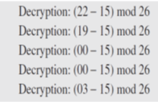
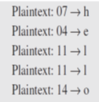
Example decrypt using additive scheme
1. Decrypt message “wtaad” using the additive cipher with key = 15 and a= 00 to decrypt.
Solution
Decrypt by subtracting 15 from ciphertext value and we need to add 26 to a negative result when subtracting (for example 00-15 = -15 therefore, -15+26 =11). Then module result with 26 will be 11%26 = 11
Encryption
Decryption
Plain Text
Ciphertext: wtaad
Plain text:
hello

Slide 16
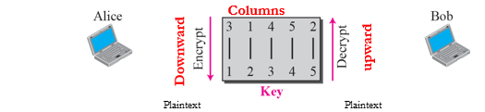

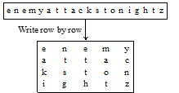
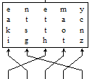
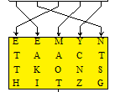
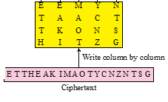

Transposition cipher reorder symbols
3
1
4
5
2

Slide 17
Categories of Cryptography
Symmetric-key cryptography
is based on sharing secrecy;
symmetric-key cryptography, symbols are permuted or substituted;
Asymmetric-key cryptography
Asymmetric-key cryptography is based on personal secrecy (not shared key).
Asymmetric-key ciphers are sometimes called public-key ciphers

Slide 18
Types of Symmetric-key cryptography
1. Data Encryption Standard (DES):
is a symmetric encryption algorithm with a fixed key length of 56 bits.
It is susceptible to brute-force attacks
encrypts data in 64-bit blocks.
It can be easily implemented and accelerated in hardware
2. Triple Data Encryption Standard (DES): steps
Step 1: The message is encrypted with the first 56-bit key, K1.
Step 2: The data is decrypted with a second 56-bit key, K2.
Step 3: The data is again encrypted with the third 56-bit key, K3.
Totally 3DES uses 168 bits key which more secure than DES

Slide 19
Types of Symmetric-key cryptography
3. Advance Encryption Standard (AES)
  is chosen to replace DES and 3DES because:
  AES is more efficient and much faster than both DES and 3DES. Because it more secure with key length
  It use 256 bit key length

Slide 20
Operational Network security:
  Firewalls and
  IDS (Intrusion Detection System)

Slide 21


Firewalls
firewall
isolates organization’s internal net from larger Internet, allowing some packets to pass, blocking others
administered
network
public
Internet
trusted “good guys”
untrusted “bad guys”
firewall

Slide 22
Why need Firewalls: ?
Because:
To prevent denial of service attacks:
prevent illegal modification/access of internal data
allow only authorized access to inside network
Generally there are three types of firewalls:
  stateless packet filters
  stateful packet filters
  application gateways

Slide 23
Stateless packet filtering
Should arriving packet be allowed in? Departing packet let out?
router filters packet-by-packet, decision to forward/drop packet based on:
  source IP address, destination IP address
  TCP/UDP source and destination port numbers
  ICMP message type
  TCP SYN and ACK bits

Slide 24
Stateless packet filtering: example
Example 1: block incoming and outgoing datagrams with either source or destination port = 23
  result: all incoming, outgoing UDP flows and telnet connections are blocked
Example 2: block inbound TCP segments with ACK=0.
  result: prevents external clients from making TCP connections with internal clients, but allows internal clients to connect to outside.

Slide 25
Stateful packet filtering
stateful packet filter: it the modernize version of packet filtering at firewall security system.
ACL(Access Control List) augmented to indicate need to check connection state table before admitting packet
action | source address | dest address | proto | source port | dest port | flag bit | check conxion
allow | 222.22/16 | outside of 222.22/16 | TCP | > 1023 | 80 | any
allow | outside of 222.22/16 | 222.22/16 | TCP | 80 | > 1023 | ACK | x
allow | 222.22/16 | outside of 222.22/16 | UDP | > 1023 | 53 | ---
allow | outside of 222.22/16 | 222.22/16 | UDP | 53 | > 1023 | ---- | x
deny | all | all | all | all | all | all

Slide 26
Application gateways
gateway-to-remote
host telnet session
host-to-gateway
telnet session
Filters packets on application data as well as on IP/TCP/UDP fields.
example: allow select internal users to telnet outside.
application
gateway
router and filter
1. require all telnet users to telnet through gateway.
2. for authorized users, gateway sets up telnet connection to destination host.
3. Gateway relays data between 2 connections (inside and outside)
4. router filter blocks all telnet connections not originating from gateway.

Slide 27
Intrusion detection systems
Intrusion: An illegitimate user gains access to someone else’s computer systems.
Intrusion detection is a technology for detecting intrusion incidents.
Closing TCP and UDP ports that may be exploited by intruders can also help reduce intrusions
IDS: intrusion detection system
  deep packet inspection: look at packet contents (e.g., check character strings in packet against database of known virus, attack strings)
  examine correlation among multiple packets
    port scanning
    network mapping
    DoS: Denial of Service

Slide 28
Intrusion detection systems
Multiple IDSs: different types of checking at different locations
demilitarized zone: is physical logical network subnetwork that separate an internal LAN from other untrusted networks usually internet
firewall
internal
network
Internet
IDS
sensors
Web
server
DNS
server
FTP
server
demilitarized
zone

Slide 29
Proxy Server
Clients never directly connect to the Internet
This saves bandwidth, because one copy of a popular Web page can be used many times
Allows a company to block forbidden Web sites
It also prevents many attacks

Slide 30
Methods of Defense
Encryption
Software Controls (access limitations in a database, in operating system protect each user from other users)
Hardware Controls (smartcard)
Policies (frequent changes of passwords)
Physical Controls
Using Anti malware(antivirus)

Slide 31
Security and protection
Overview of system security
Computer security is based on the answers to two questions:
Who do you trust?
How much do you trust them?
The specific answers to these questions are the basis for a security policy.
A typical policy will define roles and access privileges for company employees, contractors, vendors, customers, and others.
Protection refers to the set of policies and mechanisms that define how resources and the operations defined on them are protected from processes.

Slide 32
External security refers to the way user programs access networks, servers,
other hosts, and their resources and services.
In contrast to protection, where a process hopes to gain straightforward access
to an operation defined on a specific resource,
security is about understanding how processes, by accident or by design,
attempt to carry out some action to an operating system resource that could
damage it or alter it in an unacceptable way.
computer across the Internet by using a protocol (SMTP, HTTP, FTP, TCP, UDP, etc.).
Any Internet user has access to public domain resources

Slide 33
Requests for user account access to networks and servers are controlled by
login names and passwords and (for remote access) by IP addresses and port
numbers.
Users and processes are controlled in this way because untrusted users (which
the system attempts to filter out by a firewall) are likely to cause deliberate damage
by inserting viruses, worms, or spyware into the system.

Slide 34
Problem of security
Security must defend a system and its computers against mistakes and
malicious attacks by users and by automated or intelligent programs.
A system vulnerability, such as the susceptibility of a buffer or a stack to data
overflow into a protected memory space, may be exposed by a mistake (usually a
programming error) or exploited on purpose.
A malicious attack usually involves the deliberate installation of software on a
computer, which can compromise either privacy or security.

Slide 35
For instance, such an attack could install spyware, which could extract enough
information from files to lead to identity theft, credit card fraud, or other financial
loss.
Such an attack could install a virus that alters the system (attributes or
functions) in some way (usually the operating system or a popular application).
The worm may reduce the performance of the system through a denial of service
attack, a disruption that floods it with useless Internet packets.

Slide 36
Security and Protection Components
The security of a system depends on the following components:-
Physical security
User authentication
Protection
Secure communications
People
Physical Security
A computer must be protected against being lost or stolen.
Consequently, this erasure procedure should physically write to the disk, not just delete files.
If a portable computer contains highly sensitive information (e.g., credit card numbers), then it is advisable that those files and/or the entire disk be encrypted.

Slide 37
User Authentication
is the action of the system verifying (to the best of its knowledge) that users are who they say they are and that those users are permitted access to the system.
User authentication can be in the form of Something You Know.
This usually consists of a login name, a password, and a (network) domain name.
The security of such basic login schemes can be enhanced by requiring periodic password
updates, requiring a minimum password length and/ or requiring that a minimum number of
different types of characters (e.g., alpha, numeric) be used in a password so as to render it harder to guess.
Usually, after the nth failed login attempt, further attempts by that user are disabled.

Slide 38
Newer systems will combine Something You Have with Something You Know.
An example of this is using a Smart-Card, a card that the user plugs into a port on the computer-for login purposes.
The user will then be asked for a pin code (Something You Know), which will then be encrypted by the Smart-Card.
The encrypted value is sent to the network host, which will then verify it.
There are several forms of biometrics that are now starting to be used for user authentication: -
Fingerprint: Laptop computers are available that verify the user's fingerprint for logon.
Voice print: User's voice is checked and verified.
Retina scan: While very accurate, this is cumbersome to do and is currently restricted to very limited applications.
Facial imaging: Currently, this technique is not accurate enough to uniquely identify an individual.

Slide 39
Protection
A resource is an object controlled by the operating system.
It may be a software object such as a file or an application, or it may be a hardware object such as main memory, the CPU, or a peripheral device.
An operation is a function defined on that resource.
In the case of a file, for instance, operations that a process may execute on a file are create, open, copy, read, write, execute, close, and so forth.
Protection on the system consists of giving resource access to domains that should have it and denying it to domains that should not have it.
Protection on the system consists of giving resource access to domains that should have it and denying it to domains that should not have it.

Slide 40
Memory protection
Memory protection is a special case of protection in which the operating system will set up the appropriate access tables, but the enforcement is handled by the hardware.
Memory protection is used to help ensure that a program bug does not have a dangerous effect.
Typically, permission bits for read, write, and execute will be associated with each entry in the page table.
The operating system will set these bits based on information that the compiler places in the program file for the program being executed.

Slide 41
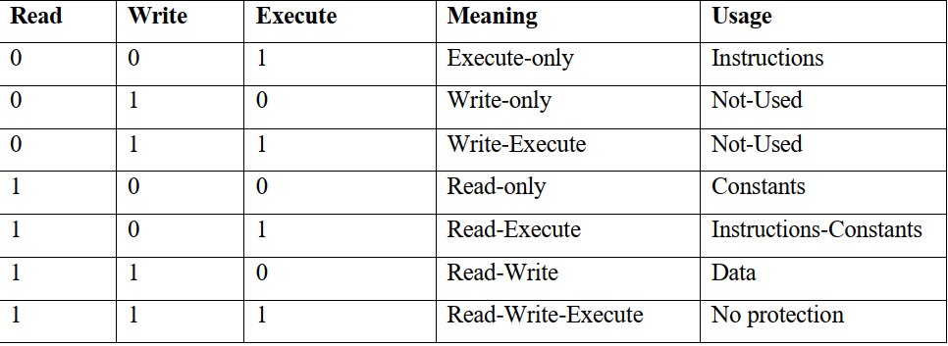
Table below shows the meaning and usage of the various combinations of permission bits.
The lack of execute permission provides an opening for hackers to penetrate a system.
Without a separate execute permission, any data area of a program is effectively executable.

Slide 42
Secure Communications
A system must ensure that its communications with other systems are secure.
In today's world, any communications over the Internet are vulnerable/exposable to eavesdropping.
Similarly, any communications over a Wi-Fi wireless link can be intercepted.
Thus, encryption should be used for any data transmitted where the physical security of the communication lines cannot be guaranteed.
Ciphertext = Encrypt (plaintext, key1)
Plaintext = Decrypt (ciphertext, key2)

Slide 43
A symmetric encryption system is one in which key1 = key2.
The sender and receiver use the same key to encrypt and decrypt the data.
This type of system requires that the key be kept secret.
Consequently, it also requires a separate secure communications channel for the sender and receiver to communicate the key.
Examples of this type of system are Data Encryption Standard (DES) and the Advanced Encryption Standard (AES)
People
The people who use a system must be properly trained in basic security concepts and the protection of information.
No matter how secure the system is technically, if the users do not practice good
security procedures, the system will be vulnerable.

Slide 44
System vulnerability
Software vulnerabilities are inherent in the operating system and most application programs.
In some cases, they were deliberately designed by the programmer in order to facilitate his or her use of the program.
In other cases, they are fundamental software defects that were not anticipated at
design time.

Slide 45
Social Engineering
is an attempt made by an attacker who pretends to be a trusted individual or institution in order to convince someone to give away confidential information such as passwords or account numbers.
There are two common examples:-
➢ Phishing is the act of sending out an email that appears to be from a trusted institution, such as the receiver's bank.
The user is asked to click on a web link to enter the desired confidential information.
The link, of course, takes the user to an attacker's website rather than the trusted institution.
➢ Pretexting involves an attacker who makes a phone call to someone in an organization and poses as someone else and asks for confidential information.

Slide 46
Social Engineering
is an attempt made by an attacker who pretends to be a trusted individual or
institution in order to convince someone to give away confidential information such as passwords or account numbers.
There are two common examples:-
➢ Phishing is the act of sending out an email that appears to be from a trusted institution, such as the receiver's bank.
The user is asked to click on a web link to enter the desired confidential information.
The link, of course, takes the user to an attacker's website rather than the trusted institution.
➢ Pretexting involves an attacker who makes a phone call to someone in an organization and poses as someone else and asks for confidential information.

Slide 47
Trojan Horse Programs
is a program that masquerades as something beneficial but actually causes damage or invades/attacks privacy.
It can also be a beneficial program that is accidentally or deliberately misused
by a programmer.
A prime example of a Trojan horse program is a terminal login emulator that
hijacks/overrides an ATM or other password access-controlled system.

Slide 48
Spyware
Spyware includes relatively harmless software cookies that monitor the user's browser habits and report them back to an application when the computer is online.
Browsers can be set so that a popup dialog box requests the browser's permission to deposit a cookie on the disk drive in exchange for access to the services provided by the website.
A common form of spyware will hijack the user's web browser so that web searches are diverted to an unexpected website.
Other spyware can search the hard drive for personal information, including:-
social security numbers, credit card numbers, driver's license numbers, and
other data that could be used to profile individuals, steal identities, or perpetrate credit card or other financial fraud (such as providing account numbers for bogus e-commerce and e-banking transactions).

Slide 49
Trap Doors
is a program fragment that issues a sequence of commands (sometimes just a special password)
that the program writers have inserted to circumvent/avoid the security system that they designed to control access to their programs.
Such activities include changing data in a database or tampering with accounting procedures and
diverting funds from a group of accounts to a private account.

Slide 50
Invasive and Malicious Software
Invasive and malicious software includes viruses and worms and any other programs that have the property of being self-replicating and/or self-propagating (they can spread themselves from one computer to another).
In addition to the ability to replicate themselves (often in hard-to-find places
such as the boot sector of another file), viruses typically have harmful side effects.
Worms are complete programs or sets of collaborating programs that have the ability to transfer themselves from one machine to another and to communicate with each other or to receive commands from a master program on a remote machine.
They can transfer themselves to any computer logged on to the Internet that they are able to access.

Slide 51
Defending the System and the User
The system can be defended against viruses in two ways.
The best method of protection against viruses is to practice safe computing.
This entails common sense practices such as setting the web
browser to detect/reject cookies and not opening or downloading email attachments from untrusted or unknown correspondents.
The best way to eliminate these viruses is by installing antivirus software that will scan all files for viruses and remove or quarantine those that it discovers.
Antivirus software should be updated often since it is only good against viruses that the programmers deemed were prevalent at the time it was written.
It is more difficult to defend the system against worms.

Slide 52
Intrusion Detection Management
There are two basic patterns for intrusion detection: -
signature-based detection and
anomaly/irregularity detection.
Like antivirus software, signature detection looks for known patterns of behavior established by previous attacks.
For instance, multiple logons to an account indicate that an intruder may be trying to guess the password to an account.
Security and Privacy
As we have said, security involves preventing the unauthorized access to information.
This is different from privacy, which involves preventing the unauthorized disclosure of information.

Slide 53
Encryptions
Encryption is the process of using an algorithm to transform information to make it unreadable for unauthorized users.
This cryptographic method protects sensitive data such as credit card numbers by encoding and transforming information into unreadable cipher text.
This encoded data may only be decrypted or made readable with a key.
Symmetric-key and asymmetric-key are the two primary types of encryption

Slide 54
What does Decryption mean?
Decryption is the process of transforming data that has been rendered unreadable through encryption back to its unencrypted form.
In decryption, the system extracts and converts the garbled data and transforms it to texts and images that are easily understandable not only by the reader but also by the system.
Decryption may be accomplished manually or automatically.
It may also be performed with a set of keys or passwords

Slide 55
System Protections
Protection can improve reliability by detecting latent errors at the interfaces between component subsystems.
Early detection of interface errors can often prevent contamination of a healthy
subsystem by a malfunctioning subsystem.
Also, an unprotected resource cannot defend against use (or misuse) by an unauthorized or incompetent user.
A protection-oriented system provides means to distinguish between authorized and unauthorized usage.
The role of protection in a computer system is to provide a mechanism for the enforcement of the policies governing resource use.

Slide 56
The application programmer needs to use protection mechanisms as well, to guard resources created and supported by an application subsystem against misuse.
Note that mechanisms are distinct from policies.
Mechanisms determine how something will be done; policies decide what will be done.
The separation of policy and mechanism is important for flexibility.
Policies are likely to change from place to place or time to time.
In the worst case, every change in policy would require a change in the underlying mechanism.
Using general mechanisms enables us to avoid such a situation.

Slide 57
Principle of protections
Frequently, a guiding principle can be used throughout a project, such as the design of an operating system.
Following this principle simplifies design decisions and keeps the system consistent and easy to understand.
A key, time-tested guiding principle for protection is the principle of less
privilege
It dictates that programs, users, and even systems be given just enough privileges to perform their tasks.
Consider the analogy of a security guard with a passkey.
If this key allows the guard into just the public areas that she guards, then misuse of the key will result in minimal damage.

Slide 58
If, however, the passkey allows access to all areas, then damage from its being lost, stolen, misused, copied, or otherwise compromised will be much greater.
Domain of protections
A computer system is a collection of processes and objects.
By objects, we mean both hardware objects (such as the CPU, memory segments, printers, disks, and tape drives) and software objects (such as files, programs, and semaphores).
Each object has a unique name that differentiates it from all other objects in the system, and each can be accessed only through well-defined and meaningful operations.
Objects are essentially abstract data types.

Slide 59
Thank you in advance!!!
This is all about the semester

Slide 60
The End !!!

